Slide 1

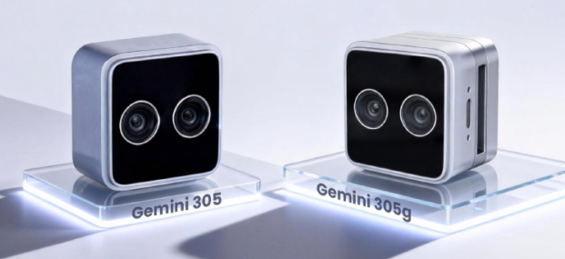
Internal Training Materials
Gemini 305/305g
Version：V1.0
Release Date：20260105

Slide 2

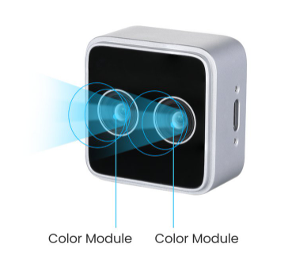

Contents
01
Product Overview
02 Product Values
03 Specifications
04 Typical Applications
05 Target Customers and Competing Products
06 Customer Development Supports

Slide 3
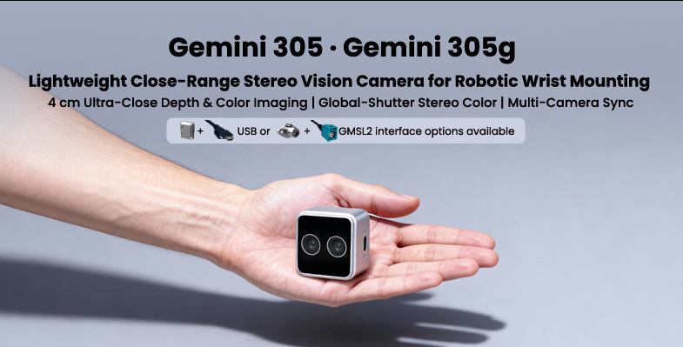
01
Product Overview
Gemini 305
Gemini 305 is a stereo vision camera designed for robotic wrist mounting.
Gemini 305 features a minimum operating range of 4 cm and a compact 68 g form factor, delivering precise visual data for recognition and grasping.
Gemini 305 offers a wide FOV, along with global shutter sensors for dynamic scenes, and real-time megapixel depth and color output.
Gemini 305’s proprietary decoupled depth–color design and dual-channel color capture with consistent ISP imaging results support diverse application needs.
Notes:
decoupled depth–color design and dual-channel color capture with consistent ISP imaging results
Depth data processing (Depth ISP) and color image processing (RGB ISP) are independent of each other and do not interfere with one another. When adjusting parameters for depth images, the original performance of color images is not affected, thereby ensuring that both types of images operate in their optimal states. This allows greater freedom in image tuning and results in more stable system performance. At the same time, synchronous acquisition from dual RGB cameras is supported, and consistent ISP imaging results are ensured across both channels. Multiple RGB viewpoints from the hand, head, and chest can output images with consistent visual characteristics, enabling more precise coordination.

Slide 4
01
Product Overview
Gemini 305g
Building on the Gemini 305’s advanced visual perception capabilities, the Gemini 305g adds a GMSL2 serializer and a FAKRA connector with highly flexible, low-loss cabling, enabling reliable cable routing under twisting and bending in robotic arm applications.
GMSL2/FAKRA connectivity gives the Gemini 305g more stable and consistent data transmission than USB cameras, enabling it to easily handle mechanical vibration, electromagnetic interference, and other environmental challenges.

Slide 5
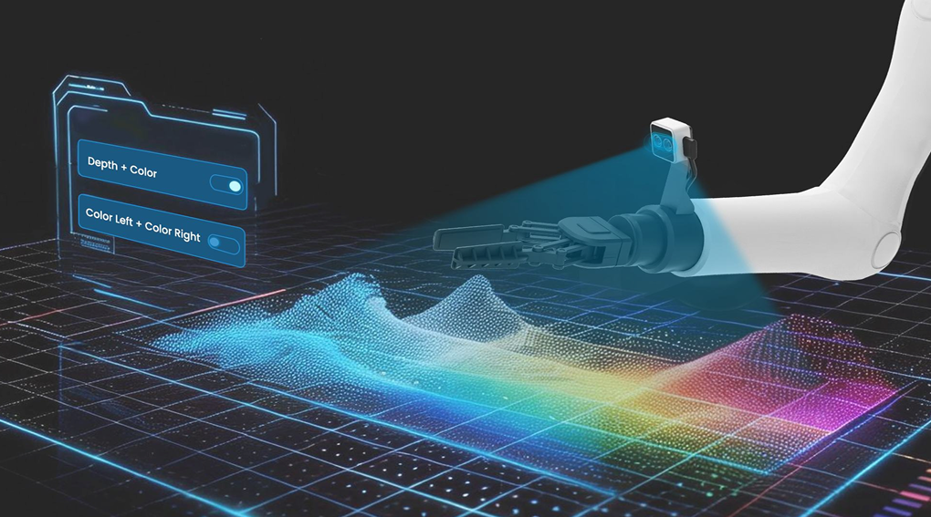
02
Product Values
1、High-Performance Sensing
· 4–100 cm Imaging Range with Sub-millimeter Accuracy at 15 cm
· Real-Time Color & Depth Streaming,
with Resolutions up to 1280 × 800 and Frame Rates up to 60 fps
· Depth to Color Aligned FOV*: H 88° × V 65° × D 98°;
Full Color FOV: H 94° × V 68° × D 104°
2、Agile Imaging
· Predefined Imaging Presets with One-Click Stream Switching
between “Depth + Color” and “Dual-Color” Combinations
· Spatial & Temporal Depth to Color Alignment
with Independently Configurable Resolutions
Notes:
Spatial & Temporal Depth to Color Alignment with Independently Configurable Resolutions
The camera’s depth and color data can be aligned in both time and space, while their resolutions can be configured independently without constraining each other. Since different tasks impose different requirements on depth and color data, this independent configuration enables targeted optimization of each data source, resulting in more efficient resource utilization and adaptability to a wide range of application requirements.

Slide 6

02
Product Values
3、Seamless Sync
· Multi-Camera Sync in Two Methods: Hardware-Sync for High Accuracy & Software-Sync for High Flexibility
· Low-Latency Direct Depth Output Down to 60 ms, Reducing Host Load
· Externally Triggered Capture for Synchronized Operation
4、Robotics-Ready Design
· IP54-rated for Dust & Splash Protection
· Temperature Adaptability: -10°C to 45°C
Notes:
Externally Triggered Capture for Synchronized Operation
The camera can be triggered to capture or acquire images through external signals, commands, or events, rather than operating in continuous automatic acquisition mode. This enables the camera to coordinate with other devices, actions, or scene events and to output signals for linked operations, such as automatically capturing images when a robot reaches out, or initiating visual recognition in response to a specific task or event trigger.

Slide 7
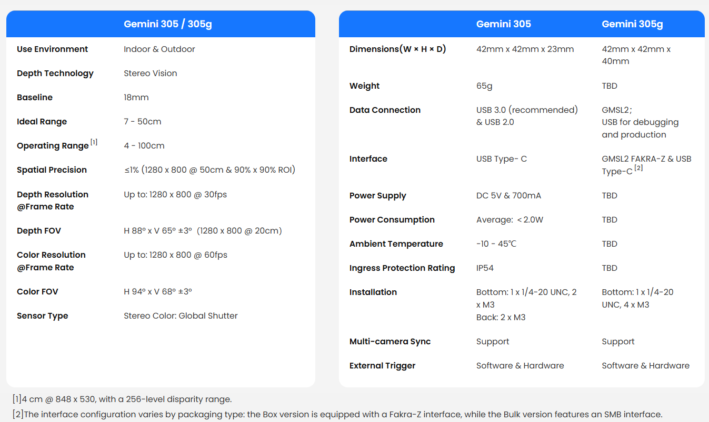
03
Specifications

Slide 8
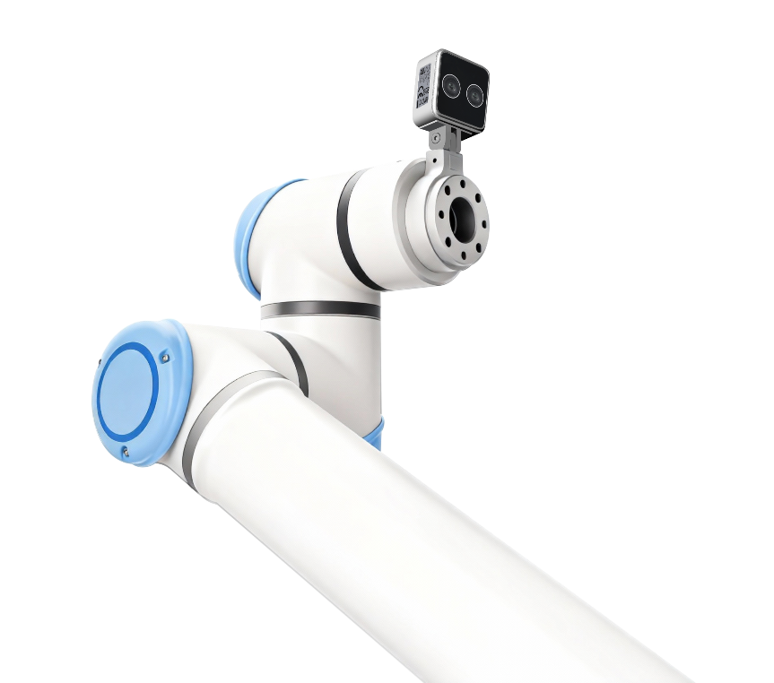

04
Typical Applications
Cobots
Humanoids

Slide 9

04
Typical Applications
A multi-camera system deployed on the robot’s hands, head, and chest operates in coordination, enabling the fusion of image data from different viewpoints to improve operational efficiency and precision.
Advantages of Using Cameras from Orbbec：
· Shared SDK with a unified functional framework
· Trigger-based acquisition supported by all cameras
· Multi-camera coordination capability
· Unified technical support

Slide 10
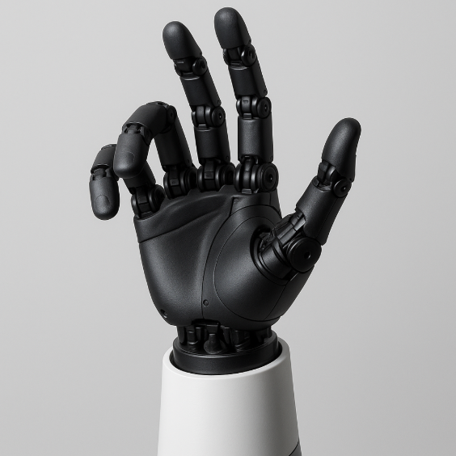
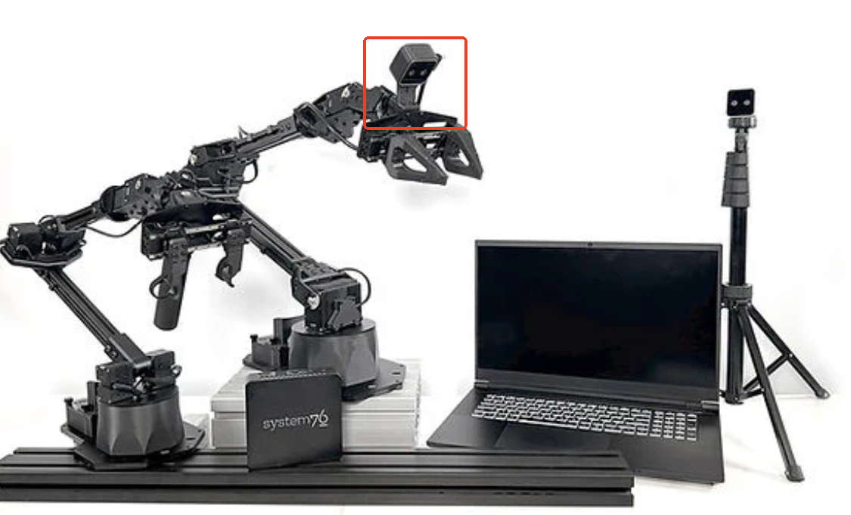
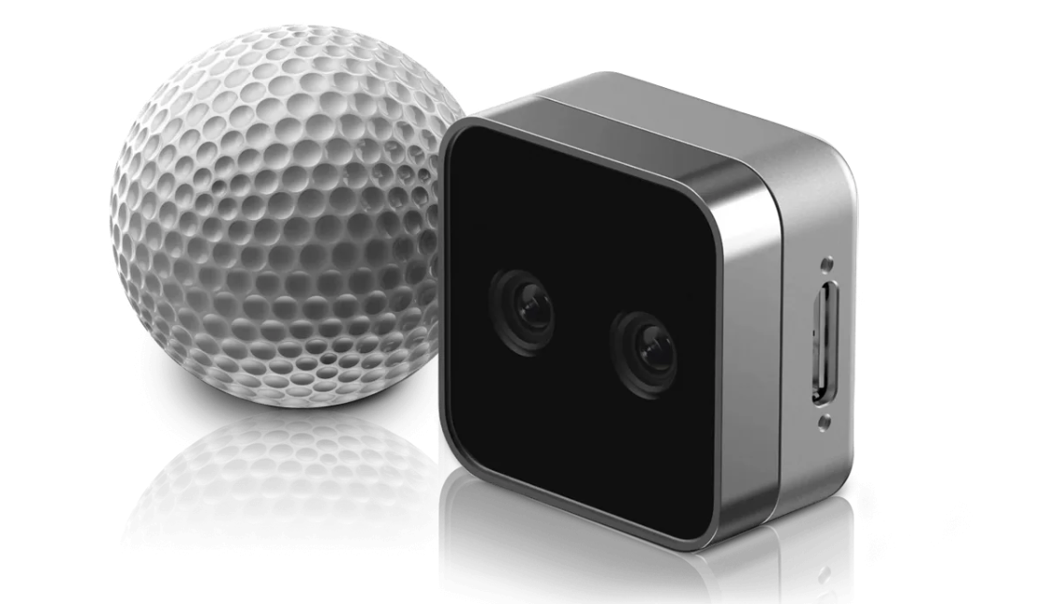
05
Target Customers and Competing Products
Target Customers
Dexterous Hand/Humanoids
End Effectors
Users of Comparable Products
Application Requirement: The camera is mounted close to the wrist to provide color and depth visual
information for guiding operations.

Slide 11
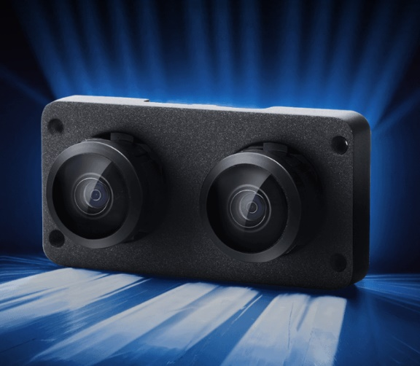
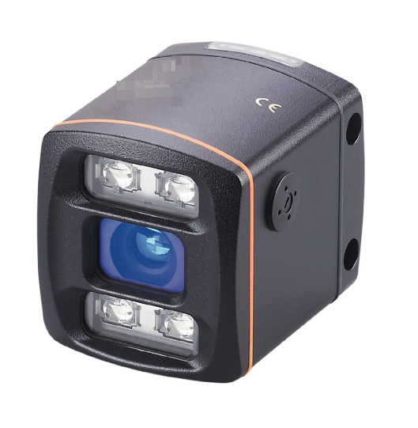
05
Target Customers and Competing Products
Competing Products
Comparable Products
2D Cameras in Stereo Configuration
ToF Cameras

Slide 12
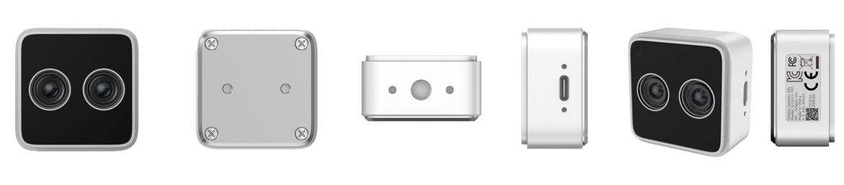
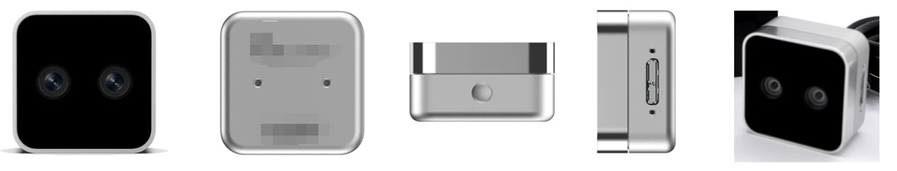
05
Target Customers and Competing Products
Gemini 305
G305 advantages over
comparable products —
✓ More competitive pricing
✓ Stronger technical support
✓ More stable supply
✓ Wider FOV with a smaller depth blind zone
✓ Support for multi-camera synchronization and triggered capture
✓ Enhanced protection: IP54 rated
✓ Dual-channel RGB support
✓ USB 3 Type-C is more universal and durable than USB 3 Micro-B
Comparable Products

Slide 13
05
Target Customers and Competing Products
Users can easily achieve seamless replacement of comparable products with Gemini 305.
Mechanical dimension compatibility:
The cameras share identical maximum external dimensions
(W × H × D: 42 × 42 × 23 mm).
Mounting compatibility:
The camera mounting and fastening screw positions are identical.
Hardware interface compatibility:
The USB interface is located in the same position across models.
Color and depth imaging performance compatibility.
Imaging range and FOV compatibility:
Imaging range from 4 to 100 cm.
Resolution and frame rate compatibility.

Slide 14
05
Target Customers and Competing Products
G305 Advantages Over ToF Cameras and 2D Cameras in Stereo Configuration
2D Cameras in
Stereo Configuration
· No native depth information; only RGB output is available, and depth computation relies on host processing resources
· Host-side depth computation significantly increases latency
· Additional algorithm libraries are required for depth calculation, increasing software management risk, complexity, and cost for customers
· Separation of hardware and algorithms can lead to unclear responsibility for depth performance issues — who is accountable?
ToF Cameras
· Low depth reliability due to multipath interference
· Limited motion compatibility due to multi-frame ToF imaging constraints
· Relatively low resolution
· Active laser illumination may cause color distortion at close range

Slide 15
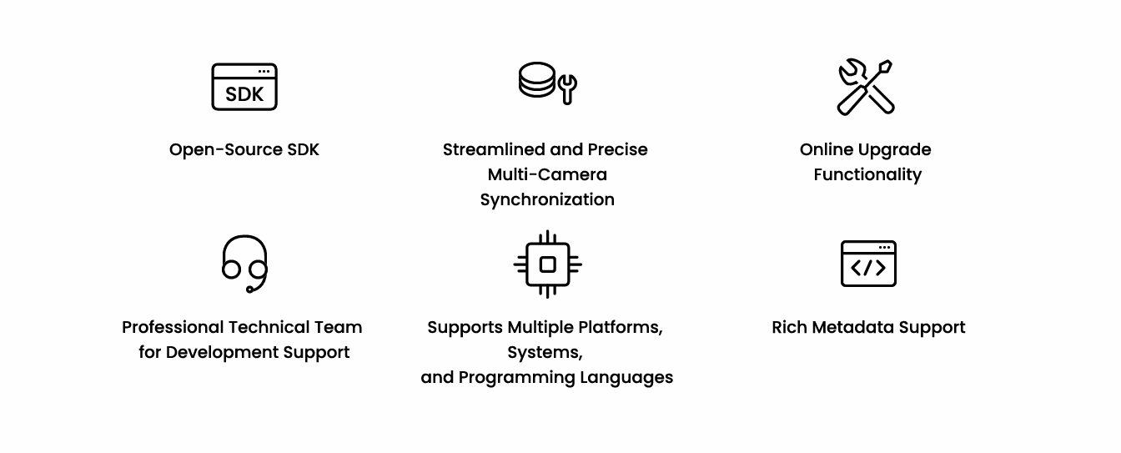
06
Customer Development Supports

Slide 16
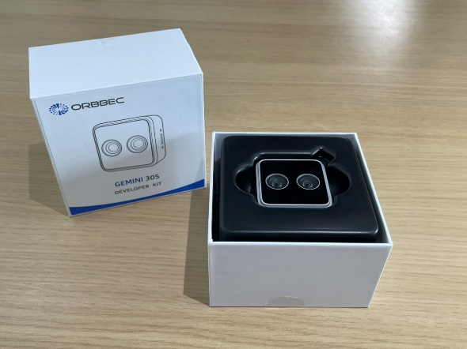
07
FAQs
Part Numbers: 100100614 – Gemini 305, White, Bulk Packaging, V1.0
100100615 – Gemini 305, White, Box Packaging, V1.0
MPQ: Boxes in Carton-30 pcs；Bulk in Carton（TBC）
What’s in the Box:
【Gemini 305】
-- 1x Gemini 305
-- 1x USB Cable(1m) C to A
-- 1x Quick Start Guide
Retail Price G305: USD 229
【Gemini 305】托盘
-- Gemini 305相机
Box Packaging
Certifications
Environmental Compliance: ROHS、Reach、WEEE
EMC：KC、CE、FCC
Sample availability: End of December
Commercial availability: End of January 2026

Slide 17
THANK YOU !

